Slide 1
Analysis of IT support Tickets
Presented by
Trivesh Sharma

Slide 2

Introduction
This presentation analyzes IT support ticket data to uncover insights about request categories, priority levels, resolution times, and satisfaction rates. We'll examine trends over time, correlations between different factors, and patterns in ticket handling. The goal is to identify areas for improvement in IT support processes and resource allocation.

Slide 3
Objective of this data analysis
Identify the trends tickets over time.
Identify the category of request having more resolution time, identify the agents having more resolution time and having less satisfaction rate.
Identify the issue related to ticket resolution whether the resolution time can be decrease through hiring more agents or upgrading in the management software.

Slide 4
Description of analytical methods and tools used.
Tools Used: Microsoft Excel
Method:
Data Format- Data stored in Excel files, suitable for analysis.
Techniques: Includes Descriptive Statistics, Categorical Analysis and Correlation Analysis for insights on ticket resolution, Pivot Table, Dashboarding.

Slide 5
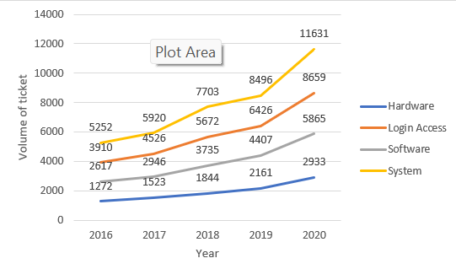
Key Insights on Ticket Trends and Agent Performance
Ticket Trends:
Upward Trend in ticket volume, especially since 2018, with an average daily volume of 35.96 tickets.
System Requests are the highest category (39,002), followed by Login Access (29,193) and Software Requests (19,570).
Agent Performance:
Each agent handled between 1,856 and 2,027 tickets, ensuring balanced workload distribution.
Average Age of Agents: 39.4 years, indicating a mix of experience.

Slide 6
Key Insights & Trends in IT Support Performance
Ticket Volume & Trends
Ticket Growth: Steady increase from 2016 to 2020; monthly ticket volume ranges from 1,046 to 2,609.
Categories with Longest Resolution Times:
Hardware Requests: 7.63 days (longest resolution time).
System Requests: 6.62 days.

Slide 7
Recommendations & Actionable Steps
Improvement Opportunities
Training Programs: Address skill gaps for agents with longer resolution times and lower satisfaction scores.
Upgrade Ticket Management Software:
Target hardware and system requests to reduce resolution times.
Streamline workflows to maintain service quality.

Slide 8
Investment Priorities
Focus on process efficiency over hiring more agents.
Enhance tech infrastructure to improve resolution times for high-resolution categories.
Trend Observations
Peak Workload: End-of-year surge in ticket volumes, especially in 2020.
Stable Periods: Mid-year months show consistent workloads and satisfaction levels.

Slide 9
Conclusion: Comprehensive Analysis of IT Support Operations
Agent Performance:
The overall performance of IT agents is satisfactory, with an average resolution time of 4.55 days and a consistent satisfaction rate of 4.1.
Specific agents with prolonged resolution times and lower satisfaction scores require targeted training programs to address skill gaps.
Category Insights:
Hardware requests have the longest resolution times (7.63 days) and demand immediate process optimization.
Login access issues are resolved quickly (0.31 days), indicating efficient handling.

Slide 10
Trends and Workload:
Ticket volumes have grown steadily, peaking at the end of the year, reflecting increased IT support demand.
Despite growing volumes, the team has maintained stable satisfaction levels, showcasing effective resource management.
Software Tools Efficiency:
Current ticket management tools are moderately effective but show room for improvement, particularly in reducing resolution times for hardware and system categories.

Slide 11
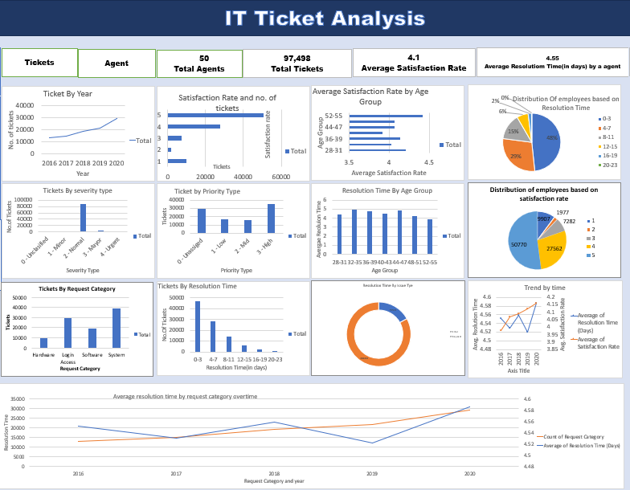

Slide 12
Recommendations
Investment Priorities:
Training programs and software upgrades should be prioritized over hiring new agents to enhance resolution efficiency.
Investment in technology can improve resolution times for high-complexity requests without significantly altering satisfaction rates.
Future Focus Areas:
Process Optimization: Streamline workflows for complex request categories (e.g., hardware and system).
Data-Driven Decisions: Monitor agent and ticket trends regularly to identify improvement areas.
Balanced Resource Allocation: Address peak workload periods through proactive resource planning and efficient prioritization.

Slide 13
Thank You

